Slide 1
Software Engineering Unit-1 INTRODUCTION

Slide 2
What is software?
Software is an instruction or computer program that provide desired features, functions and performance while executed.
Software products may be developed for a particular customer or may be developed for a general market.
Software products may be:-
Generic - developed to be sold to a range of different customers
Bespoke (custom) - developed for a single customer according to their specification

Slide 3





Software Examples
Examples
Operating Systems, Internet browser, Movie Player, Antivirus, Games(PUBG) etc…
Applications

Slide 4
What is Software Engineering ?
Software engineering
Software engineering is an engineering discipline which is concerned with all aspects of software production.
It is the science and art of building (designing and writing programs) a software systems that are:
1) on time
2) on budget
3) with acceptable performance
4) with correct operation

Slide 5
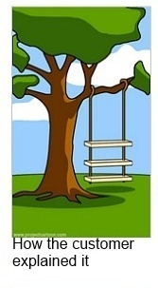






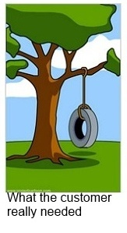

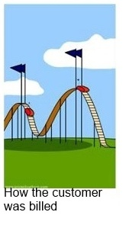
Product Development from an IT failures perspective
© http://www.projectcartoon.com/

Slide 6
The Evolving Role of Software
Dual Role of Software
A product
as an information transformer —
producing, managing, acquiring, modifying, displaying and/or transmitting information
The vehicle for delivering a product
the control of the computer (Ex. operating systems),
the communication of information (Ex. Networking software) and
the creation of other programs (Ex. software tools)

Slide 7
Software Applications
Software categorization based on their application areas
System Software
Business Software
Engineering and Scientific Software
Personal Computer Software
Web-based Software
Artificial Intelligence Software
Real-time System
Embedded System

Slide 8




1) System Software
Interacts with hardware and provides interface to other applications.
Examples
Operating System, Device Driver, Compiler, File Management Utilities etc…
Applications

Slide 9


2) Business Software
Software applications that are used by business users to perform various business functions.
Examples
Accounting System, Enterprise resource planning (ERP) etc…
Applications

Slide 10
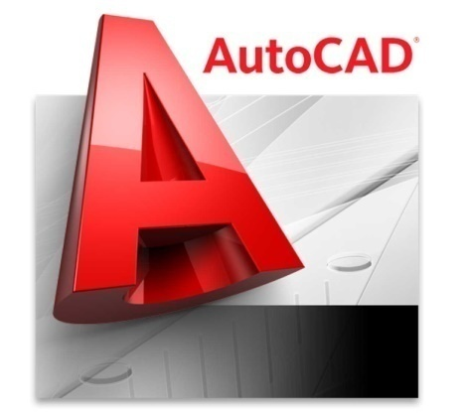

3) Engineering and Scientific Software
Number crunching algorithms used to solve scientific problems
Examples
Matlab, Autocad etc…

Slide 11



4) Personal Computer Software
Prolific (productive) application domain
Examples
Word processing software, Spreadsheets, Multimedia Software etc…
Applications

Slide 12



5) Web-based Software
The web pages retrieved by a web browser
Examples
Websites, Webpages
Applications

Slide 13


6) Artificial Intelligence Software
Computer systems able to perform tasks normally requiring human intelligence
Examples
Speech Recognition, Visual Perception, Decision-making and Translation between Languages etc..
Applications

Slide 14
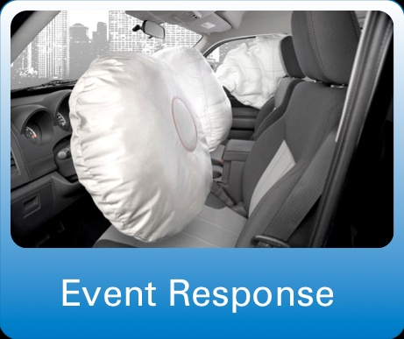
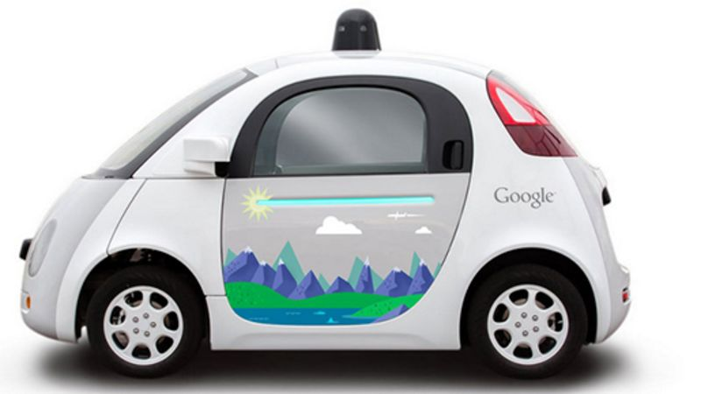
7) Real-time System
Monitor, Analyse and Control the real time events.
Examples
Vehicle Event Controller, Air traffic control system etc…
Applications

Slide 15
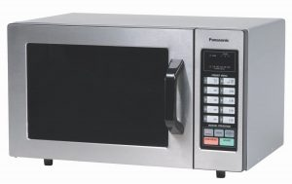
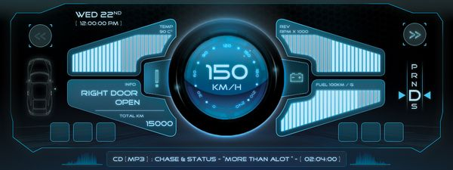
8) Embedded System
Resides in read-only memory (ROM) of a device and is used to control its functions
Examples
Keypad Control for a Microwave Oven, Digital Functions in an Automobile such as Fuel Indicator, Dashboard Displays and Braking Systems
Applications

Slide 16
Software Crisis
Crises refers to a set of problems encountered in the development of computer software.
As a result of crisis
1). Schedule and Cost estimates were often grossly inaccurate.
2). Productivity of programmers could not keep up the demand.
3). Poor quality s/w was developed.

Slide 17
Reasons of software crisis
1) Lack of communications between s/w developers and users.
2) Increase in cost of software compared to hardware.
3) Increase in size of software.
4) Increase in Complexity of problem.
5) Project management problems.
6) Lack of understanding problems and its improvement.
7) High optimistic estimates regarding s/w development time and cost.

Slide 18
Myth
Myth is commonly believed but false idea.
Software myths propagated misinformation and confusion.
Following are the types of myths:-
Management’s Myth.
Customer’s Myth.
Practitioner’s Myth.

Slide 19
1) Management’s Myths.
1) We already have a book that’s full of standards and procedures for
building software. Won’t that provide my people with everything they
need to know?
2) If we get behind schedule, we can add more programmers and catch up(sometimes called the “Mongolian horde” concept).
3) If I decide to outsource the software project to a third party, I can just relax and let that firm build it.
4) My people have state-of-the-art software development tools, after all, we buy them the newest computers.

Slide 20
2) Customer’s Myths.
1) A general statement of objectives is sufficient to begin writing
programs—we can fill in the details later.
2) Software requirements continually change, but change can be easily
accommodated because software is flexible.

Slide 21
3) Practitioner’s Myths.
1) Once we write the program and get it to work, our job is done.
2) Until I get the program “running” I have no way of assessing its quality.
3) The only deliverable work product for a successful project is the working program.

Slide 22
Software Characteristics V/S Hardware Characteristics
Software is a logical rather than a physical system (Physical Product).
Therefore, software product has characteristics that are considerably different than hardware (physical products)
Software is developed or engineered, it is not manufactured in the classical sense.
Software doesn't "wear out.“
Although the industry is moving toward component-based assembly, most software continues to be custom built.

Slide 23
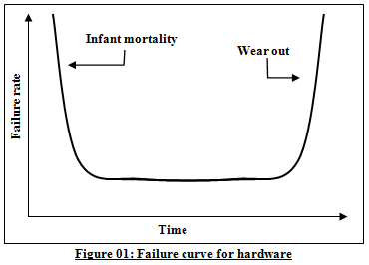
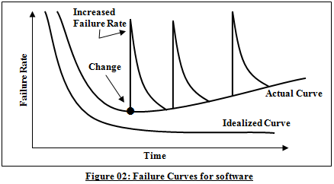
Hardware V/S Software

Slide 24
Software Engineering: A Layered Technology
Software engineering in practice is built of 3 main layers
Process
Methods
Tools
3. Tools
2. Methods
1. Process
“Quality” focus

Slide 25
Software Engineering: A Layered Technology
Software Engineering Tools allows automation of activities which helps to perform systematic activities.
A system for the support of software development, called computer-aided software engineering (CASE).
Examples: Testing Tools, Bug/Issue Tracking Tools etc…
3. Tools
2. Methods
Practices with proven techniques to perform certain activities
Examples: Encompass a broad array of tasks that include communication, requirements analysis, design, construction, testing and support
1. Process
“Quality” focus
Foundation layer for software engineering.
Framework with order of activities.
Examples: Sequence of Requirement Gathering, Design, Development, Testing activities
Defines continuous process improvement principles

Slide 26
Software Process Models
Also known as Software development life cycle (SDLC) or Application development life cycle Models
Process models prescribe a distinct set of activities, actions, tasks and milestones required to engineer high quality software.
Process models are not perfect, but provide roadmap for software engineering work.
Software models provide stability, control and organization to a process that if not managed can easily get out of control.
Software process models are adapted (adjusted) to meet the needs of software engineers and managers for a specific project.

Slide 27
SDLC Phases
Project Initiation
Requirements Gathering
Communication
Delivery
Support
Feedback
Estimation
Scheduling
Tracking
Planning
Deployment
SDLC
Analysis
Design
Construction
Modelling
Coding
Testing

Slide 28
The Linear Sequential Model (Waterfall model)
Communication
This Model also called as the Classic life cycle or the Waterfall model.
The Linear sequential model suggests a systematic sequential approach to software development.
Once a phase is complete, you cannot go back and repeat the process of previous phase.
Planning
Modelling
Construction
Deployment

Slide 29
Cont…
When to use ?
Requirements are very well known, clear and fixed
Product definition is stable
Technology is understood
There are no ambiguous requirements
Sufficient resources with required expertise are available freely
The project is short

Slide 30
Cont..
Advantages
Simple to implement and manage
Drawbacks
Unable to accommodate changes at later stages, that is required in most of the cases.
Working version is not available during development. Which can lead the development with major mistakes.
Deadlock can occur due to delay in any step.
Not suitable for large projects.

Slide 31
The Prototyping Model
Serves as a mechanism for identifying software requirements.
Prototype can be serve as “the first system”.
Quick planning and modeling.
Feedback from customer will refine requirement.
Both customers and developers like this paradigm.
Customer/End user gets a feel for the actual system.
Developer gets to build something immediately.
Quick Plan
Communication
Modelling:
Quick Design
Deployment:
Delivery
and Feedback
Prototype Construction

Slide 32
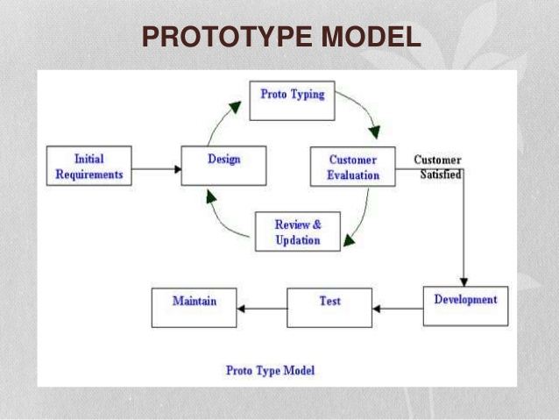

Slide 33
When to Use ?
Customers are not sure about the detail input, output and requirements.
Developers are not sure about the technical feasibilities.
Advantages
Users are actively involved in the development
Since in this methodology a working model of the system is provided, the users get a better understanding of the system being developed.
Errors can be detected much earlier.
Disadvantages
Leads to implementing and then repairing way of building systems.
Incomplete or insufficient problem analysis.

Slide 34
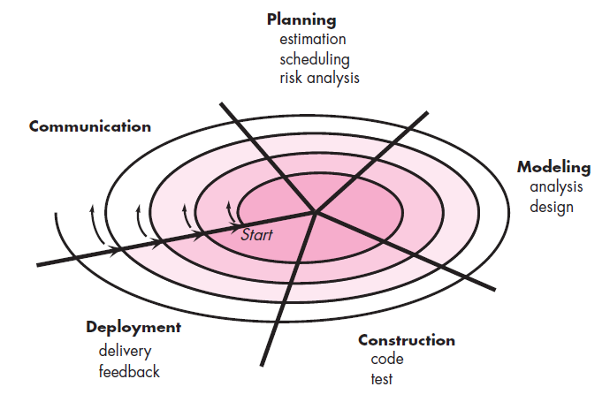
Spiral Model

Slide 35
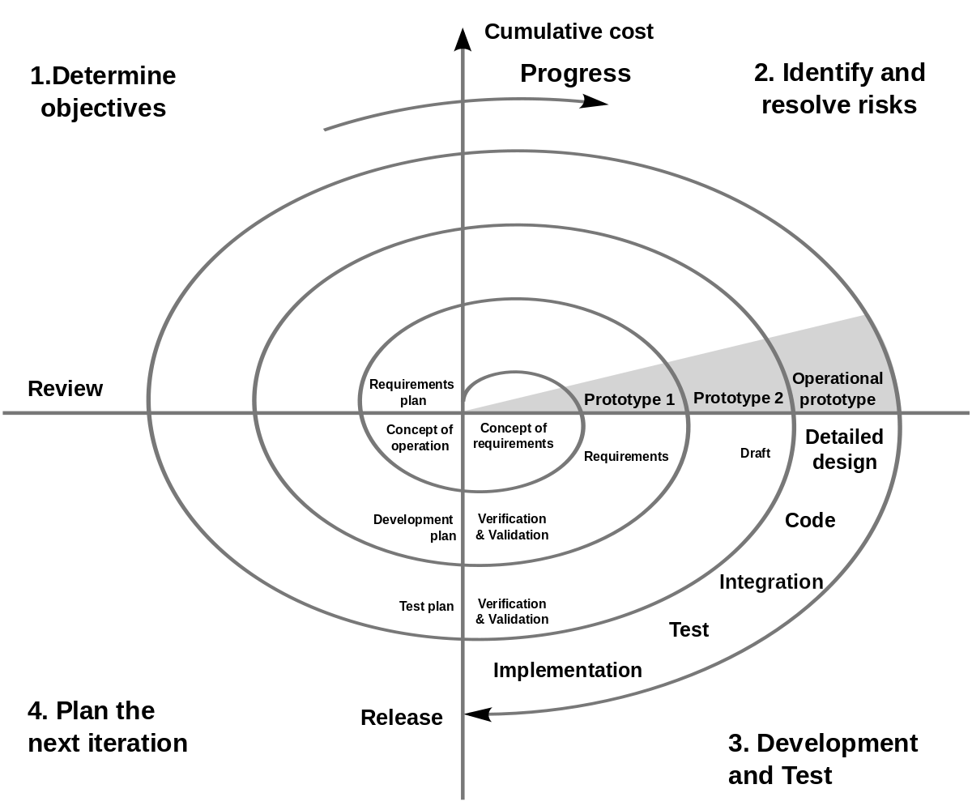

Slide 36
Spiral model
Couples iterative nature of prototyping with the controlled and systematic aspects.
Using spiral, software developed in a series of evolutionary release.
Early iteration, release might be on paper or prototype.
Later iteration, more complete version of software.
Divided into framework activities (C,P,M,C,D). Each activity represent one segment.
The spiral model is a realistic approach to the development of large scale system and software.

Slide 37
Cont…
When to use Spiral Model?
When costs and risk evaluation is important.
For medium to high-risk projects.
Users are unsure of their needs.
Requirements are complex.
Significant changes are expected.

Slide 38
Cont…
Advantages
High amount of risk analysis hence, avoidance of Risk is enhanced.
Good for large projects.
Strong approval and documentation control.
Additional Functionality can be added at a later date.
Software is produced early in the Software Life Cycle.
Disadvantages
Can be a costly model to use.
Risk analysis requires highly specific expertise.
Project’s success is highly dependent on the risk analysis phase.
Doesn’t work well for smaller projects.

Slide 39
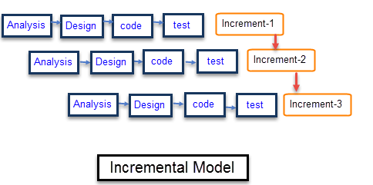
Incremental Model
System development is broken down into many mini development projects
Partial systems are successively built to produce a final total system
Highest priority requirement is tackled first
Once the incremented portion is developed, requirements for that increment are frozen

Slide 40
Cont…
When to use?
Requirements of the system are clearly understood
When demand for an early release of a product arises
When software engineering team are not very well skilled or trained
When high-risk features and goals are involved
Such methodology is more in use for web application and product based companies

Slide 41
Cont…
Advantages
The software will be generated quickly during the software life cycle.
It is flexible and less expensive to change requirements and scope.
This model is less costly compared to others.
Errors are easy to be identified.
Disadvantages
It requires a good planning designing.
Each iteration phase is rigid and does not overlap each other.
Rectifying a problem in one unit requires correction in all the units and consumes a lot of time

Slide 42
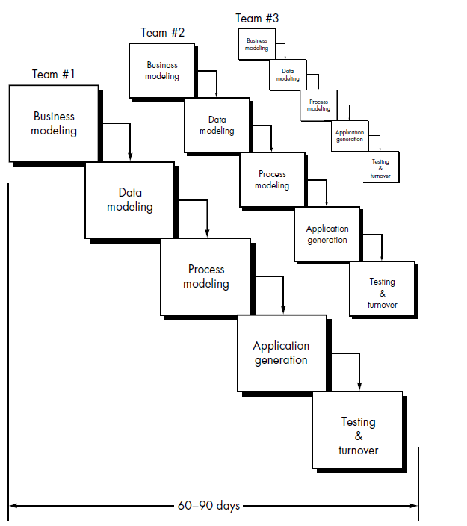
RAD Model

Slide 43
RAD
It is a type of incremental model in which; components or functions are developed in parallel as if they were mini projects.
The developments are time boxed, delivered and then assembled into a working prototype.
This can quickly give the customer something to see and use and to provide feedback.
When to Use ?
There is a need to create a system that can be modularized in 2-3 months of time.
High availability of designers and budget for modeling along with the cost of automated code generating tools.
Resources with high business knowledge are available.

Slide 44
Advantages
Reduced development time.
Increases reusability of components.
Quick initial reviews occur.
Encourages customer feedback.
Integration from very beginning solves a lot of integration issues.
Drawback
For large but scalable projects, RAD requires sufficient human resources.
Projects fail if developers and customers are not committed in a much shortened time-frame.
Problematic if system can not be modularized.
Not appropriate when technical risks are high (heavy use of new technology).

Slide 45
Concurrent Development Model
Inactive
Allow a software team to represent iterative and concurrent elements of any of the process models.
The Figure shows modeling may be in any one of the states at any given time.
Each activity, action or task on the network exists simultaneously with other activities, actions or tasks.
It is applicable to all types of software development and provides an accurate picture of the current state of a project.
Modelling Activity
Under Development
Awaiting Changes
Under Review
Under Revision
Baselined
Done

Slide 46
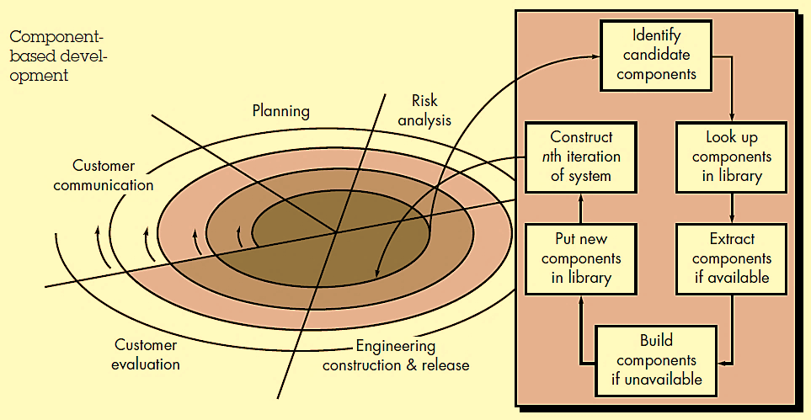
Component-Based Development

Slide 47
Component Based Development
Consists of the following process steps
Available component-based products are researched and evaluated for the application domain.
A software architecture is designed to accommodate the components.
Complete testing is conducted to ensure proper functionality.
Relies on a robust component library.
Capitalizes on software reuse, which leads to savings in project cost and time.

Slide 48
Product and Process
If the process is weak, the end product will suffer. But an overreliance on process is also dangerous.
People derive as much satisfaction from the creative process as they do from the end product.
Like an artist enjoys the brush strokes as much as the framed result.
A writer enjoys the search for the proper metaphor (comparison) as much as the finished book.
As creative software professional, you should also derive as much satisfaction from the process as the end product.
The duality of product and process is one important element in keeping creative people engaged as software engineering continues to evolve.

Slide 49
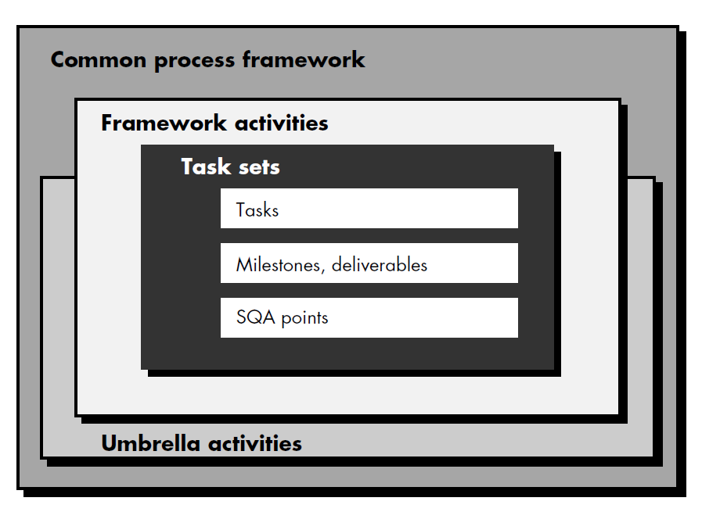
Process framework

Slide 50
Process Framework
A common process framework is established by defining a small number of framework activities that are applicable to all software projects, regardless of their size or complexity.
A number of task sets—each a collection of software engineering work tasks, project milestones, work products, and quality assurance points—enable the framework activities to be adapted to the characteristics of the software project and the requirements of the project team.
Finally, umbrella activities—such as software quality assurance, software configuration management, and measurement2—overlay the process model.
Umbrella activities are independent of any one framework activity and occur throughout the process.

Slide 51
Process Framework
Typical umbrella activities are:
Software project tracking and control
Risk management
Software Quality Assurance (SQA)
Formal Technical Reviews (FTR)
Measurement
Software Configuration Management (SCM)
Reusability management
Work product preparation and production

Slide 52
CMMI
CMMI stands for “Capability Maturity Model Integration”
Capability Maturity Model is used as a benchmark to measure the maturity of an organization's software process.
It is a framework which is used to analyze the approach and techniques followed by any organization to develop a software product.
It also provides guidelines to further enhance the maturity of those software products.
This model describes a strategy that should be followed by moving through 5 different levels.

Slide 53
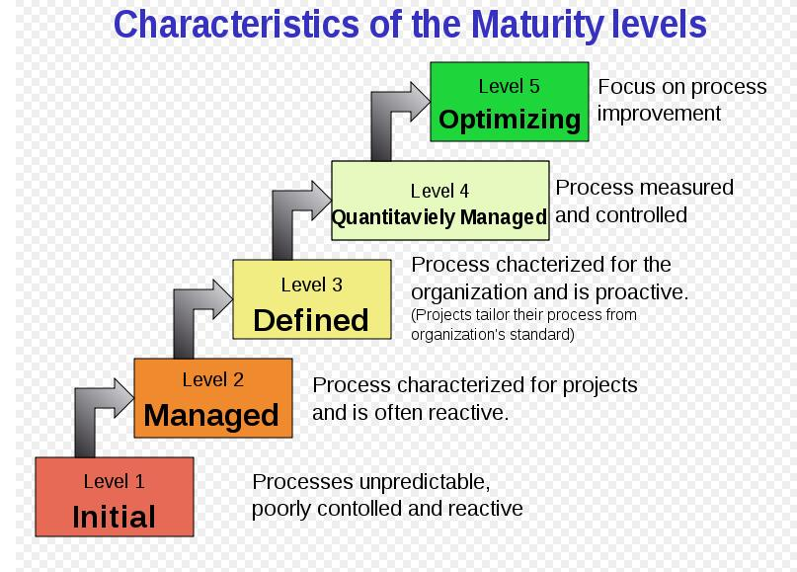

Slide 54
CMMI
Level 1 (Initial): The software process is characterized as ad hoc and occasionally even chaotic. Few processes are defined, and success depends on individual.
Level 2 (Managed):Basic project management processes are established to track cost, schedule, and functionality. The necessary process discipline is in place to repeat earlier successes on projects with similar applications.
Level 3 (Defined):The software process for both management and engineering activities is documented, standardized, and integrated into an organization wide software process. All projects use a documented and approved version of the organization's process for developing and supporting software.
Level 4 (Quantitatively Managed):Detailed measures of the software process and product quality are collected. Both the software process and products are quantitatively and controlled using detailed measures. This level includes all characteristics defined for level 3.
Level 5 (Optimized):Continuous process improvement is enabled by quantitative feedback from the process and from testing innovative ideas and technologies. This level includes all characteristics defined for level 4.

